Slide 1


Recipe for a Hit Song on YouTube and Spotify
A data journey showing the commonalities of the attributes of top 10 tracks for two thousand Artists
Sean Papworth
Data Analyst in training
Gayle Murphy
Data Analyst in training²

Slide 2
Genesis
Brainstorming
A discussion of our hobbies and interests led to YouTube videos / music.
---
What are the popular songs on YouTube and Spotify?
Who are the top 50 artists by likes?
Who are the bottom 50 artists by likes?
What are some attributes that make up the top liked songs?
Can we break it down to distinct combinations of attributes to predict if a song will be popular or not?

Slide 3
The Data Source
We were able to find a published data set on Kaggle.com about the top 10 songs from (~2k unique) artists and the songs’ different measurable attributes as listed below.
Track: name of the song, as visible on the Spotify platform.
Artist: name of the artist.
Energy: is a measure from 0.0 to 1.0 and represents a perceptual measure of intensity and activity. Typically, energetic tracks feel fast, loud, and noisy. For example, death metal has high energy, while a Bach prelude scores low on the scale. Perceptual features contributing to this attribute include dynamic range, perceived loudness, timbre, onset rate, and general entropy.
Speechiness: detects the presence of spoken words in a track. The more exclusively speech-like the recording (e.g. talk show, audio book, poetry), the closer to 1.0 the attribute value. Values above 0.66 describe tracks that are probably made entirely of spoken words. Values between 0.33 and 0.66 describe tracks that may contain both music and speech, either in sections or layered, including such cases as rap music. Values below 0.33 most likely represent music and other non-speech-like tracks.
Acousticness: a confidence measure from 0.0 to 1.0 of whether the track is acoustic. 1.0 represents high confidence the track is acoustic.
Instrumentalness: predicts whether a track contains no vocals. "Ooh" and "aah" sounds are treated as instrumental in this context. Rap or spoken word tracks are clearly "vocal". The closer the instrumentalness value is to 1.0, the greater likelihood the track contains no vocal content. Values above 0.5 are intended to represent instrumental tracks, but confidence is higher as the value approaches 1.0.
Liveness: detects the presence of an audience in the recording. Higher liveness values represent an increased probability that the track was performed live. A value above 0.8 provides strong likelihood that the track is live.
Valence: a measure from 0.0 to 1.0 describing the musical positiveness conveyed by a track. Tracks with high valence sound more positive (e.g. happy, cheerful, euphoric), while tracks with low valence sound more negative (e.g. sad, depressed, angry).
Likes: number of likes

Slide 4
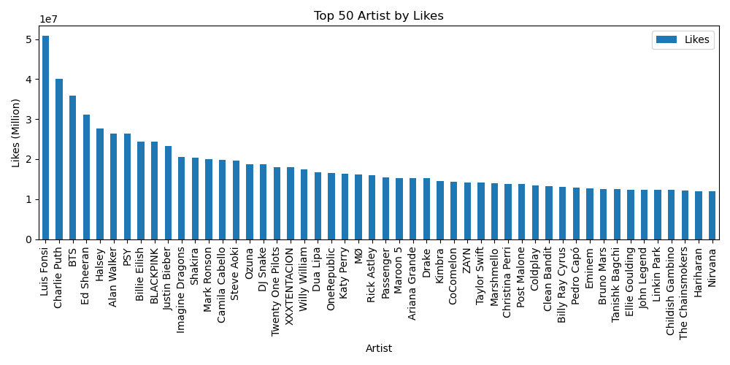
Top 50…

Slide 5
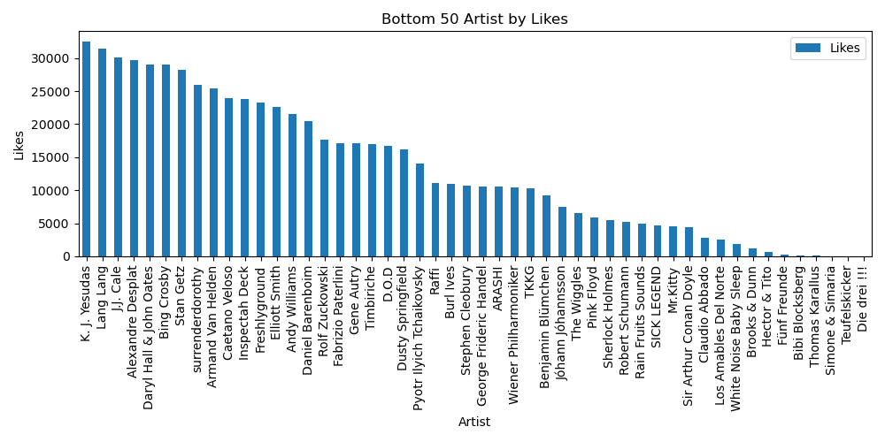
…And Bottom 50

Slide 6
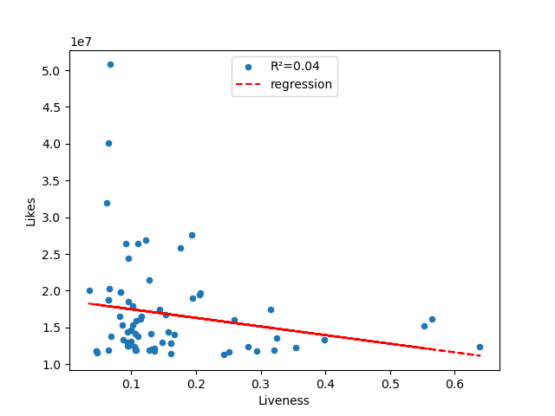
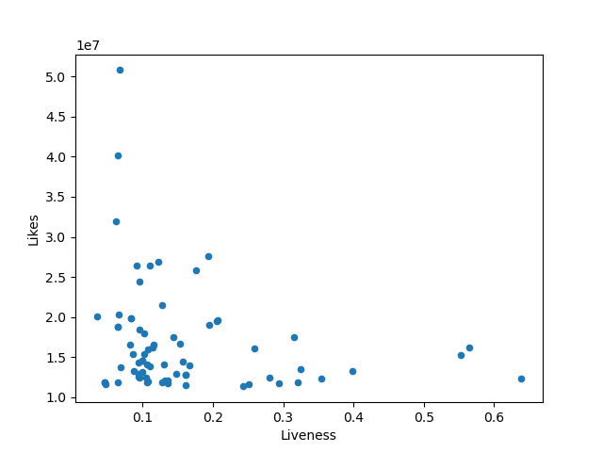
THEY WANT TO HEAR THE ARTISTS, NOT THE AUDIENCE Liveness In this chart, you can easily see the decline in popularity with tracks recorded live, or even with some audience noise captured.

Slide 7
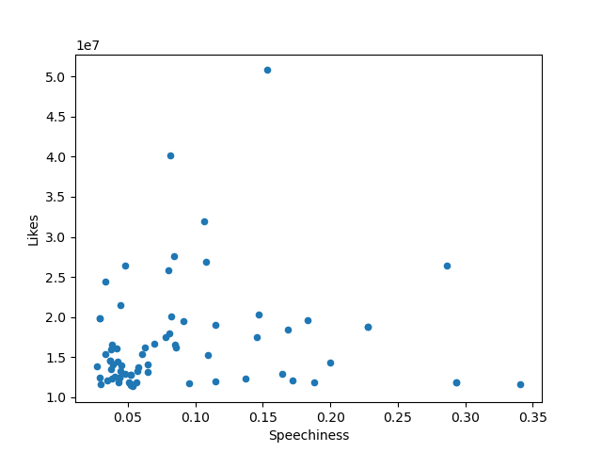
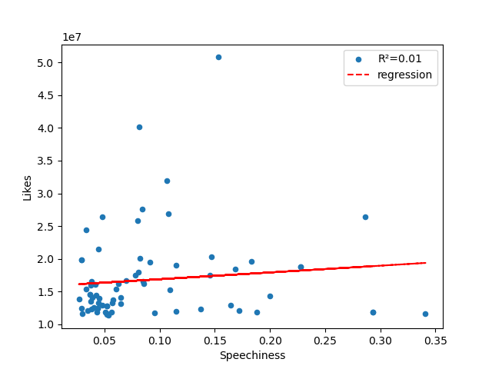
Shhhh…. Speak less… or is it sing less? Less wordy songs tend to get the likes.

Slide 8
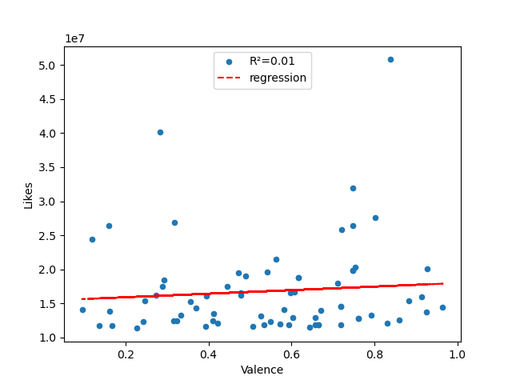
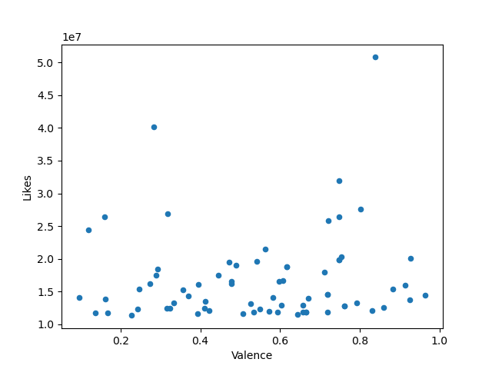
Don’t Worry… Be Happy!!!
Valence measures the “happiness” of a song. This shows a slight positive correlation to the popularity of a song indicating lighter songs sprinkled with positivity, will help with its popularity.

Slide 9

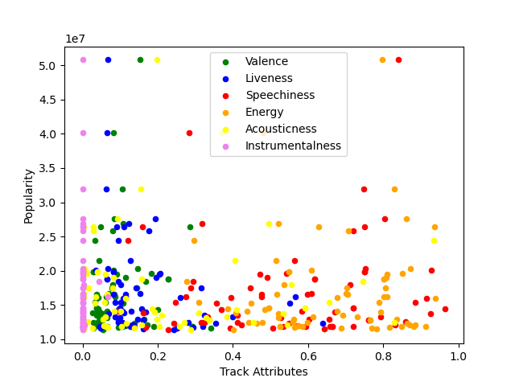
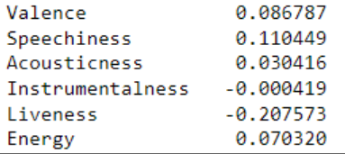
According to the data on hand, and as shown in the correlation table below, the three attributes with the strongest correlation to a song’s popularity are Liveness, Instrumentalness, and Valence.

Slide 10

Conclusion Based on the data we analyzed, the variability of tracks liked on Spotify and YouTube, gave us a very weak probability of providing a conclusive statement. However, there is a very slight chance that artists can get another hit song if they write and record songs that are happier and with a positive tone, with less words, and less “live” background noise!!

